Slide 1
Airline
Satisfaction
Group 1 | Alberto Attie Hanono, Alisha Tran, Bella Davies, Daniel Chen, Matthew Batacan, Naveen Vaidyamath, Roubing Liao

Slide 2

Why does flight satisfaction matter?

Slide 3
8% Decrease
1.4 Billion $ Lost
In overall Airline Satisfaction
In revenue due to customer experience shortcomings
https://www.forbes.com/sites/blakemorgan/2023/06/01/new-data-about-airlines-competing-on-customer-experience/?sh=573cdde24904
https://www2.deloitte.com/us/en/pages/consumer-business/articles/airline-customer-experience.html
https://www.airship.com/blog/alaska-airlines-customer-experience-data/
Notes:
https://www.forbes.com/sites/blakemorgan/2023/06/01/new-data-about-airlines-competing-on-customer-experience/?sh=573cdde24904
https://www2.deloitte.com/us/en/pages/consumer-business/articles/airline-customer-experience.html
https://www.airship.com/blog/alaska-airlines-customer-experience-data/

Slide 4

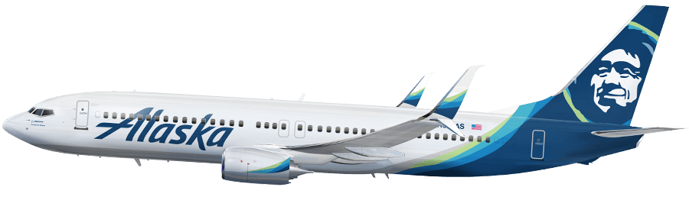
Highest in the Fleet
#1 Airline by American Customer Satisfaction Index
“Alaska is a quiet underdog in the airline industry” - Forbes
On-Time Flights
Speedy Check-In
Industry-leading Loyalty Program
https://www.forbes.com/sites/blakemorgan/2023/06/01/new-data-about-airlines-competing-on-customer-experience/?sh=573cdde24904
https://www2.deloitte.com/us/en/pages/consumer-business/articles/airline-customer-experience.html
https://www.airship.com/blog/alaska-airlines-customer-experience-data/

Slide 5
Based on airline variables, which predictive model is most effective in determining an airline passenger satisfaction score?
Problem Statement

Slide 6
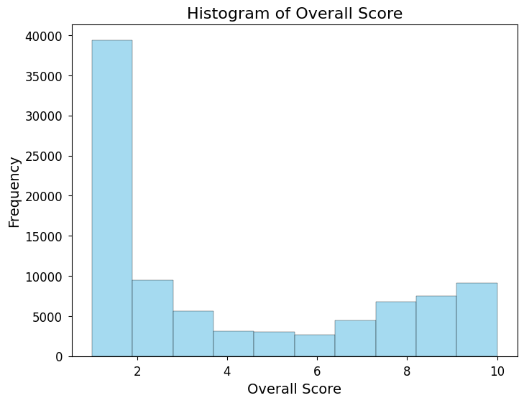
Dataset
Raw Data: 22 Columns, 129455 Rows
Source: Kaggle, scraped from AirlineQuality.com
Cleaned Data: 17 Columns, 91145 rows
Numerical: 8
Categorical: 9
Outcome Variable:’OverallScore’ Rating
Scale from 1.0 to 10.0, with 10.0 as satisfied and 1.0 as unsatisfied

Slide 7


Data Cleaning
Data Cleaning Steps:
Dropping non-relevant columns
Aircraft, AirlineName, DateFlown, DatePub, OriginCountry, Review, Route, Slug, Title, unique_id, TripVerified
One-hot encoding categorical variables
Dropping rows with null values
Final Columns:
Entertainment Rating
Food Rating
Ground Service Rating
Overall Score
Recommended
Seat Comfort Rating
Service Rating
Value Rating
Wifi Rating
Cabin Type: Business, Economy and First Class
Travel Type: Business, Couple Leisure, Family Leisure, Solo Leisure

Slide 8
Naive Model
Use the mean of overall score as a baseline of what a good MSE is
Overall Score Mean: 3.98
MSE Test
11.882

Slide 9
Linear Regression
CV Scores
MSE Train
MSE Test
[1.012, 1.022, 0.992, 1.018, 1.064]
Average: 1.022
0.7843
0.8834
Best Polynomial Feature Degree: 4

Slide 10
Ridge Regression
CV Scores
MSE Train
MSE Test
[1.012, 1.022, 0.993, 1.018, 1.064]
Average: 1.022
1.021
1.031
1.031
Best Alpha: 27.825
Lowest coefficients: CabinType_First Class, CabinType_Premium Economy, TravelType_Couple Leisure
Largest Coefficients: Recommended, ValueRating

Slide 11
Lasso Regression
CV Scores
MSE Train
MSE Test
[1.012, 1.022, 0.992, 1.018, 1.064]
Average: 1.022
1.021
1.031
Best Alpha: 0.001
0-coefficients: CabinType_First Class, CabinType_Premium Economy, TravelType_Couple Leisure
Largest Coefficients: Recommended, ValueRating

Slide 12
ElasticNet Regression
CV Scores
MSE Train
MSE Test
[1.012, 1.022, 0.992, 1.018, 1.064]
Average:1.022
1.021
1.031
1.031
Best Alpha: 0.001
0-coefficients: CabinType_First Class, CabinType_Premium Economy, TravelType_Couple Leisure
Largest Coefficients: Recommended, ValueRating

Slide 13
Single Decision Tree
CV Scores
MSE Test
MSE Train
[1.435, 1.436, 1.449, 1.440, 1.497]
Average: 1.451
0.299
1.427

Slide 14
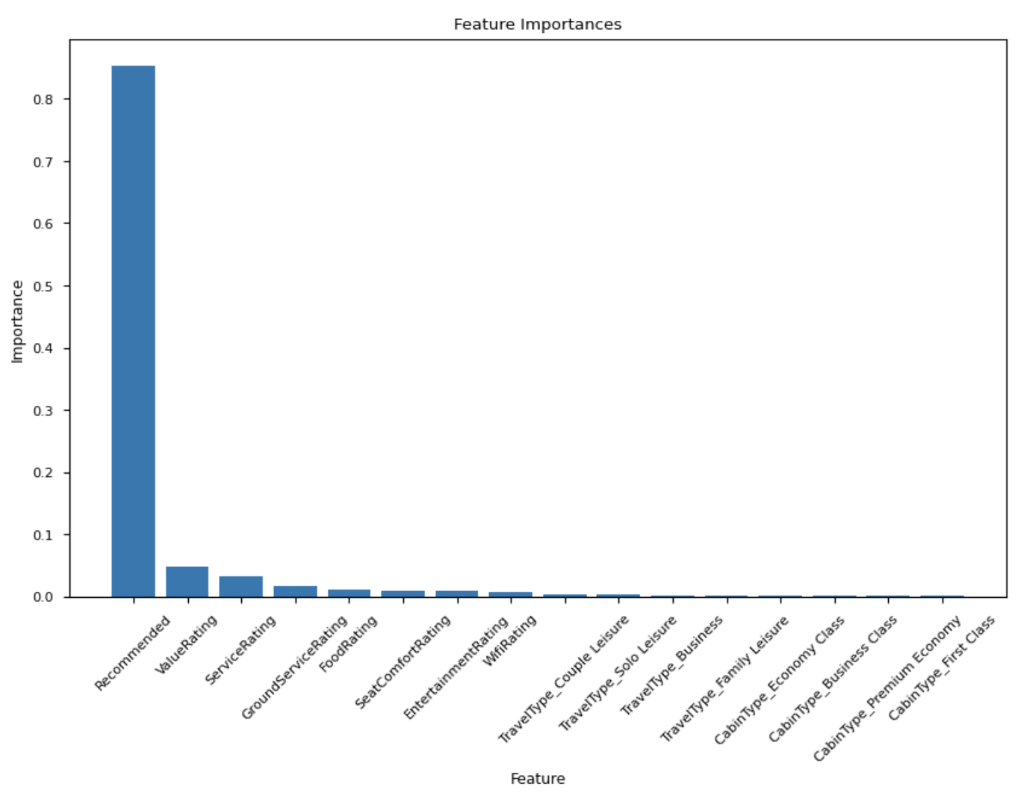
Single Decision Tree

Slide 15
Random Forest
CV Scores
MSE Test
MSE Train
Best Parameters
[0.854, 0.861, 0.843, 0.843, 0.899]
Average: 0.860
0.739
0.860
max_depth = 10, n_estimators = 200

Slide 16
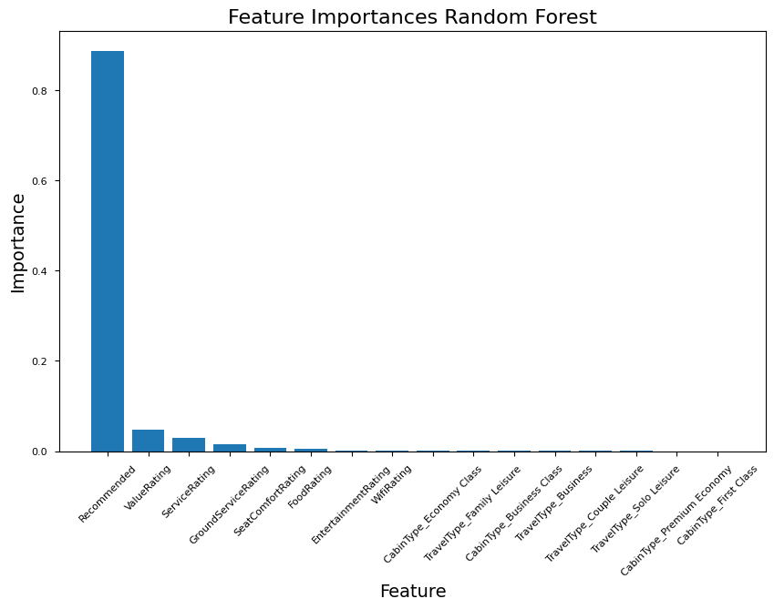
Random Forest

Slide 17
Boosting
CV Scores
MSE Test
MSE Train
Best Parameters
[1.362, 1.330, 1.385, 1.259, 1.304]
Average: 1.451
1.106
1.116
learning_rate: 0.01
loss: ‘linear’
n_estimators: 200

Slide 18
K-Nearest Neighbor
CV Scores
MSE Train
MSE Test
Best K-value
[0.917, 0.916, 0.920 , 0.917, 0.914]
Average: 0.917
0.914
0.979
40

Slide 19
Neural Network
CV Scores
MSE Test
MSE Train
Best Parameters
[0.919, 0.895, 0.888, 0.868, 0.860]
Average: 0.886
0.842
0.883
Hidden Layer Sizes: 16-32-64

Slide 20
Top Three Models and Their Performance
Conclusion
Model | Training MSE | Testing MSE | Cross Validation Score
1. Random Forest | 0.739 | 0.860 | 0.860
2. Neural Network | 0.852 | 0.869 | 0.886
3. Linear Regression | 0.784 | 0.883 | 1.022
The model that worked the best for our project was Random Forest, with a MSE test of 0.859 , MSE train of 0.739, and average cross validation score of 0.860.

Slide 21
Limitations & Implications
Dataset
Unknown Factors
Selection Bias
Our original dataset provided only 2 possible ratings, so we switched datasets in order to use regression on 10 ratings.
Unaccounted factors, such as connecting flights, may influence passenger satisfaction beyond what is considered in this dataset.
Survey data may only include reviews from customers who had either below-average or above-average experiences.
Notes:
One of the biggest challenges we faced was our original dataset leaned heavily on classification which made it difficult for us to interpret it in a way appropriate for regression models. We overcame this by making the tough decision to switch datasets mid project that had 1 to 10 ratings.
A limitation of our dataset is that there are many unaccounted factors such as whether or not the passenger was coming from a connecting flight which can greatly affect satisfaction.
Lastly, since we are using survey data, there can be bias on who answers the survey and the results they give us.

Slide 22




Our Takeaways
Data Cleaning and Processing
Splitting Data
Train, Test, Validation
Tuning Machine Learning Models
Model Evaluation and Selection
Notes:
In terms of takeaways, I think this was a good experience for us to learn more about working on a real world dataset and applying all the methods we learned in class. In this process, we practiced with data cleaning and processing, splitting datasets, tuning machine learning models and model evaluation and selection.

Slide 23


Future Steps
Model Improvement
Airline Industry
To improve this model, some further steps that can be taken include:
Further tuning and optimization of hyperparameter
Explore more complex models and ensemble methods
Airline Companies and Industry can use this dataset to:
Predict passenger satisfaction for a given flight
Identify specific areas for flight improvement:
For example, improving food or entertainment may improve overall passenger satisfaction

Slide 24
Thank you!

Slide 25
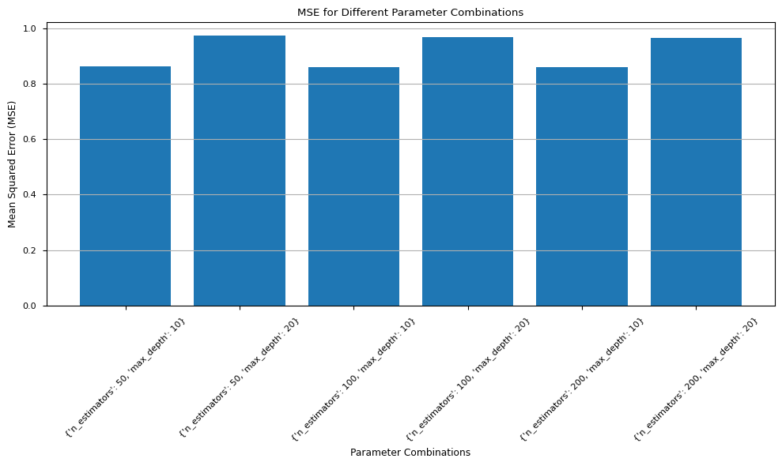
Random Forest MSE

Slide 26
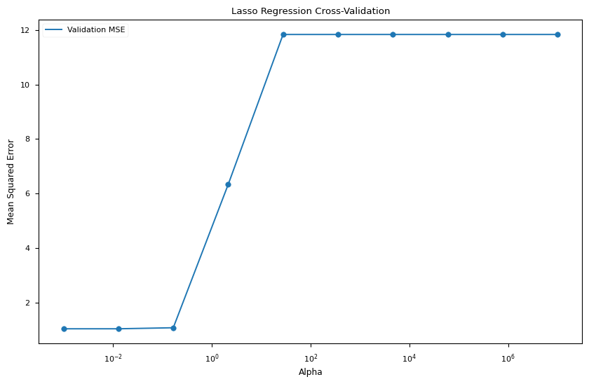
Lasso Regression

Slide 27
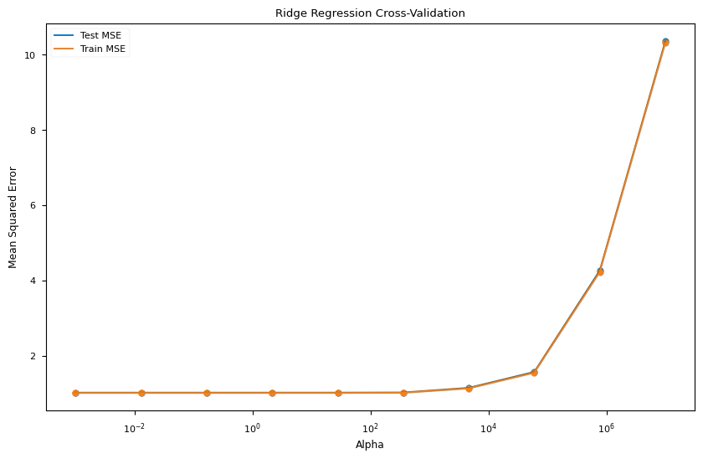
Ridge Regression

Slide 28
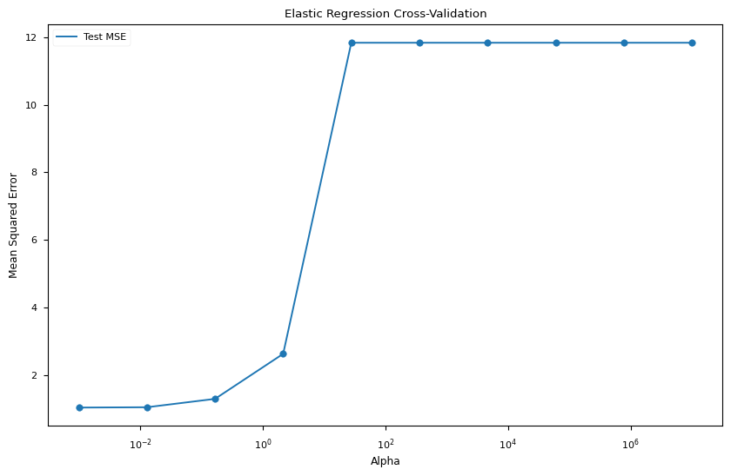
Elastic Regression

